Slide 1
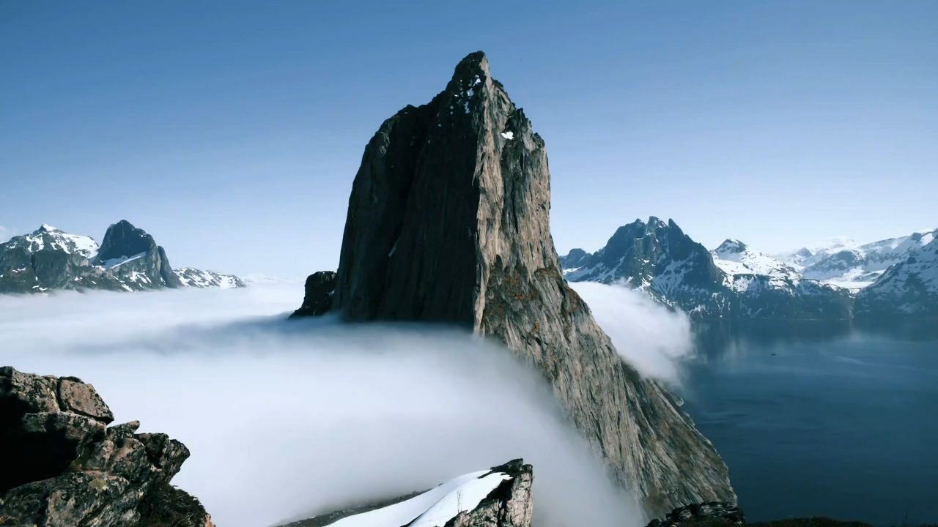



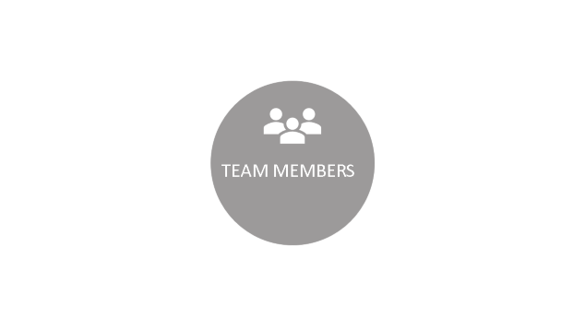



Slide 2
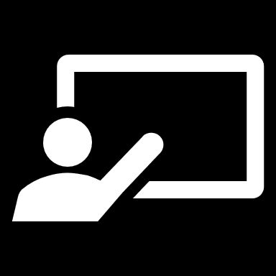
CTS application demo comes as a result of software engineering project tasks on this semester. Today we will present three out of sixteen of CTS functionalities which are “Choose role”, “Login” and “Edit info” and one example of non-functional requirements. For each functionality we will took about it’s workflow , Action and the source code. In addition, we will have In this demo motivation which includes “Why it’s important” and “Goals”. Finally we will have a small conclusion for our demo.
INTRODUCTION

Slide 3
CTS application demo comes as a result of software engineering project tasks on this semester. Today we will present three out of sixteen of CTS functionalities which are “Choose role”, “Login” and “Edit info” and one example of non-functional requirements. For each functionality we will took about it’s workflow , Action and the source code. In addition, we will have In this demo motivation which includes “Why it’s important” and “Goals”. Finally we will have a small conclusion for our demo.
INTRODUCTION

Slide 4
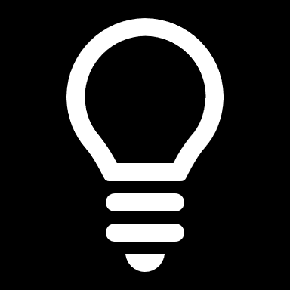


MOTIVATION

Slide 5
MOTIVATION

Slide 6
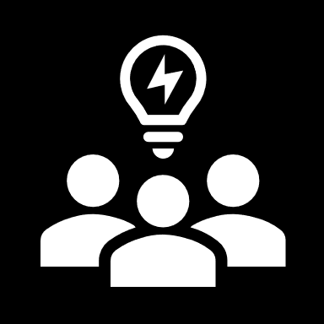
Helping visitors
Tracking for classrooms
Present faculty members offices
Present exams schedules
Organize student courses
Why it’s important

Slide 7

Helping visitors
Tracking for classrooms
Present faculty members offices
Present exams schedules
Organize student courses
Why it’s important

Slide 8
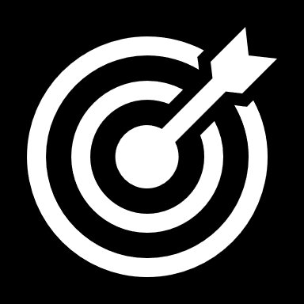
Visitors can search for any classroom.
Students can search for classroom or faculty member office and add their courses.
Faculty member can add his exams and courses.
Viewing the schedules for students and faculty staff.
Goals

Slide 9
Visitors can search for any classroom.
Students can search for classroom or faculty member office and add their courses.
Faculty member can add his exams and courses.
Viewing the schedules for students and faculty staff.
Goals

Slide 10
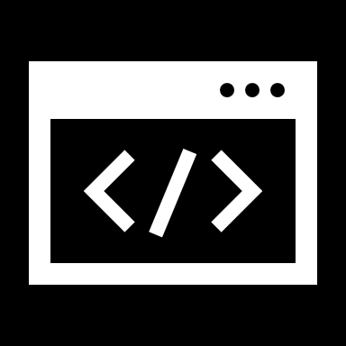

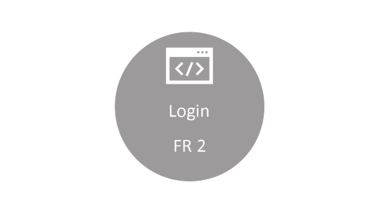
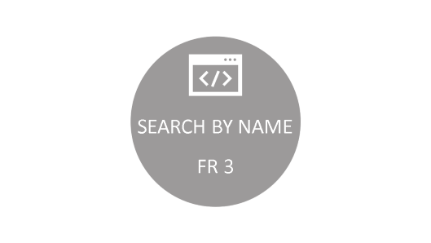
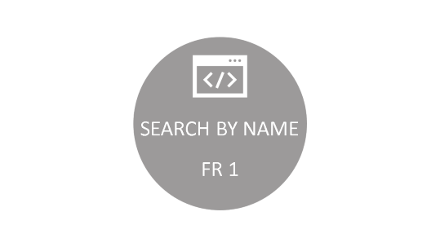

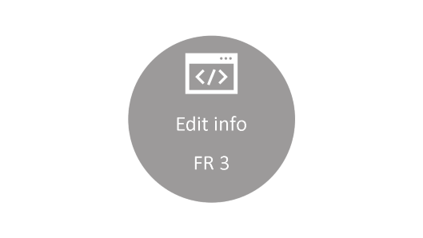
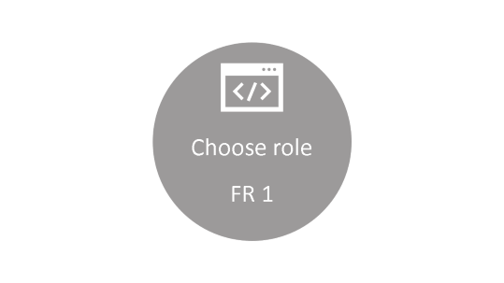
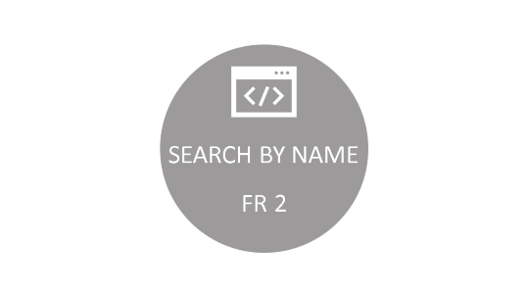
REQUIREMENTS

Slide 11
REQUIREMENTS

Slide 12
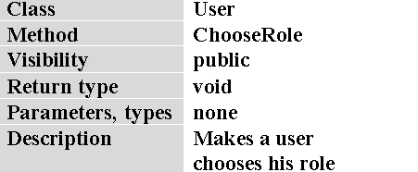
Choose role
FR 1

Slide 13
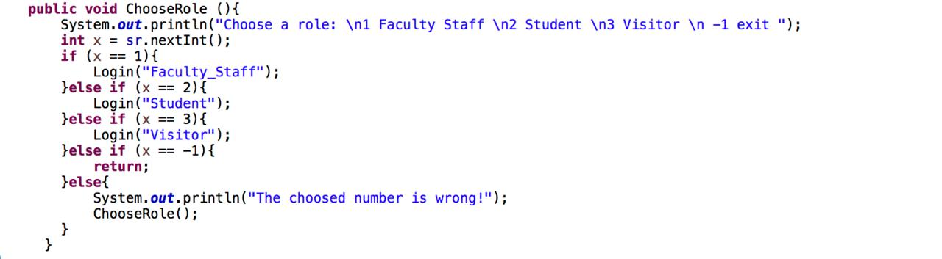
Choose role
Login
FR 2

Slide 14
Choose role
Login
FR 2

Slide 15
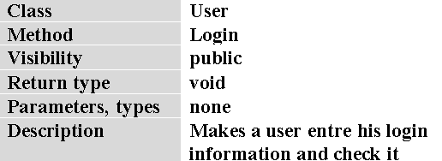
Login
FR 2

Slide 16
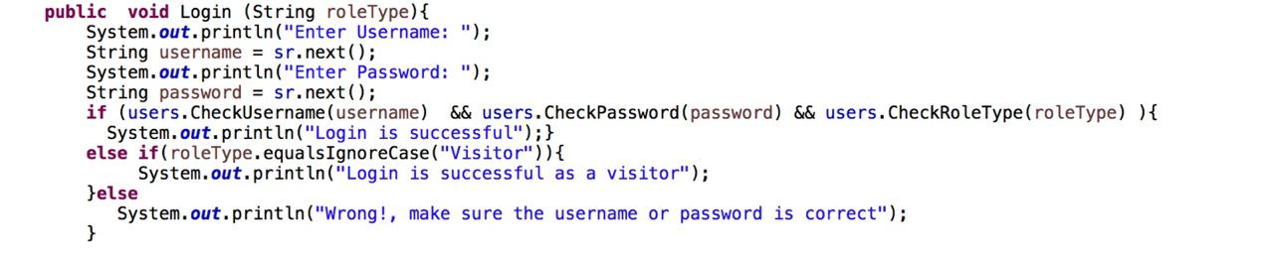
Login
FR 2

Slide 17
Login
Edit info
FR 3

Slide 18
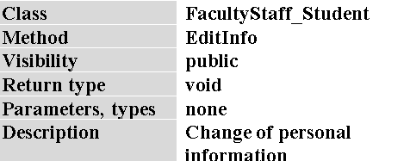
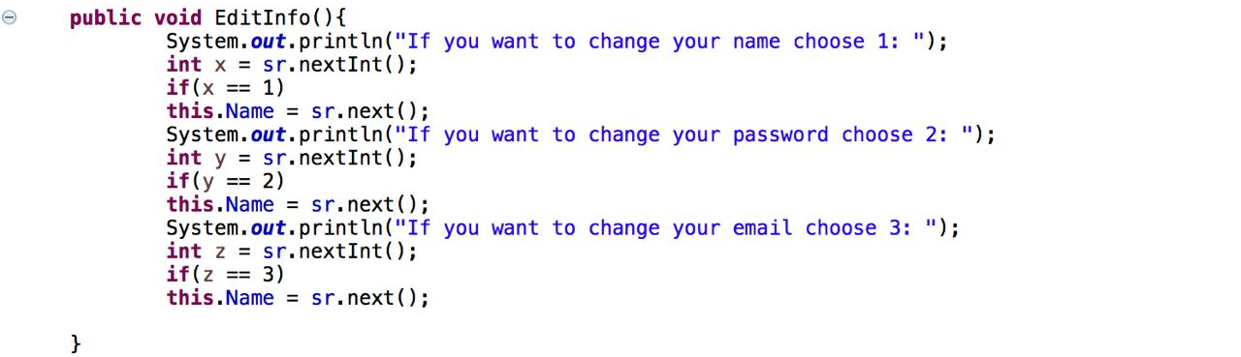
Edit info
FR 3

Slide 19
Edit info
FR 3

Slide 20
Edit info
FR 3

Slide 21
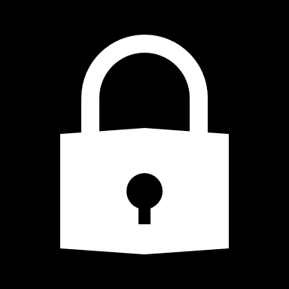
SECURE INFORMATION
NON-F

Slide 22
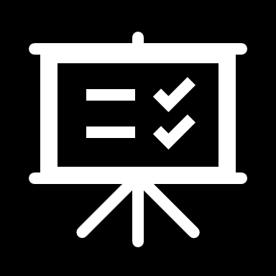
To conclude our demo for CTS application project, we will summarize the demo in points which are general introduction to the demo, motivation and requirement section which includes functional and non-functional requirement. Finally, we hope that our application give advantage to computer science college members and visitors.
CONCLUSION

Slide 23
To conclude our demo for CTS application project, we will summarize the demo in points which are general introduction to the demo, motivation and requirement section which includes functional and non-functional requirement. Finally, we hope that our application give advantage to computer science college members and visitors.
CONCLUSION

Slide 24
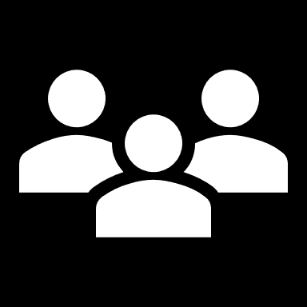
Name | Profile | Profile URL
Ahmed majed Alotaibi | AhmedMaj | AhmedMaj.github.io
Fahad abdulaziz Alshaya | FahadAlshaya | FahadAlshaya.github.io
Mohammed Khaled Alnasser | Mohamadns | Mohamadns.github.io
Khalid abdulaziz Alotaibi | Kaalotaibi37 | Kaalotaibi37.github.io
Ibraheem Al-tuwayijiri | IbrahemSaleh | IbrahemSaleh.github.io
TEAM MEMBERS
Supervisor
Dr.Sultan Alqahtani

Slide 25
TEAM MEMBERS
Name | Profile | Profile URL
Ahmed majed Alotaibi | AhmedMaj | AhmedMaj.github.io
Fahad abdulaziz Alshaya | FahadAlshaya | FahadAlshaya.github.io
Mohammed Khaled Alnasser | Mohamadns | Mohamadns.github.io
Khalid abdulaziz Alotaibi | Kaalotaibi37 | Kaalotaibi37.github.io
Ibraheem Al-tuwayijiri | IbrahemSaleh | IbrahemSaleh.github.io
Supervisor
Dr.Sultan Alqahtani

